Slide 1
Welcome to the SECOND Canadian CMTC-OVM CONFERENCE
Saturday May 6, 2017
Cobourg, Ontario

Slide 2
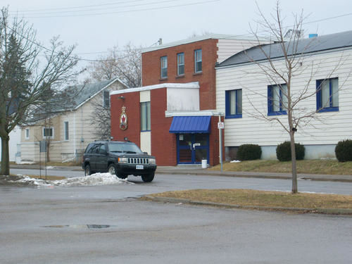
This conference was made possible with a generous donation from the Royal Canadian Legion Branch 133 and their women’s auxiliary .

Slide 4
Board of Directors
President/Executive Director Treasurer
Jennifer Cormier Margaret Gee
8972 Oak Ridges Dr, 17 Gardiner Crescent
Gores Landing Ontario K0K 2E0 Cobourg, Ontario K9A 1W7
Cell (905) 376-4087 905-396-8564
Jcormier.cmtc@yahoo.ca mgee.cmtc@yahoo.ca
Vice President Secretary
Case Noel Megan Thompson
446 Burnet Dr, 9714 County Rd East RR #5
Cobourg Ontario K9A 1B3 Cobourg, Ontario K9A 4J8
(905) 269-5993 (905) 375-5098
caseynoel607@gmail.com mthompson.cmtc@yahoo.ca
Board Member Board Member
Sherry Duckworth Samuel Cormier
190 Brook Rd. S, 8972 Oak Ridges Dr.
Cobourg, Ontario K9A 4J8 Gores Landing , Ontario K0K 2E0
(905) 375-9482 (613) 401-6535
Sduckworth.cmtc@yahoo.ca scormier.cmtc@yahoo.ca
Board Member
Lex Van Der Heijden
Lex.van.der.heijden@cmtc.nl

Slide 5
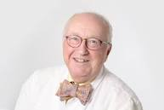
In Memory of Dr. Oranje
Dr. Arnold Oranje
It is with great sadness that we announce the passing of Dr. Oranje on October 19th, 2016. Dr. Oranje was one of the medical advisers for the Netherlands organization and was kind enough to come to Canada last April to speak at our very first conference and provide consultations for individuals with CMTC. We were so lucky to have him as an advisor and a friend of our CMTC-OVM Community. Dr. Oranje gave our daughter Ireland her diagnosis in July 2010 in Washington D.C. He was one of the very first physicians our family met in the world of vascular anomalies who knew anything about these very rare conditions. We are forever grateful to him and send all our love and prayers to his family, friends, colleagues, and patients in the Netherlands.

Slide 6
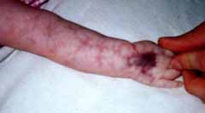
Cmtc-ovm Cutis Marmorata Telangiectatica Congenital (Van Lohuizen Syndrome) – Other Vascular Malformations

Slide 7
Introduction
Cutis marmorata telangiectatica congenita (CMTC) is a rare skin condition which was first described by the Dutch pediatrician 'van Lohuizen' around 1920 (thus, CMTC is sometimes referred to as 'van Lohuizen syndrome').
CMTC is a condition in which dilated blood vessels can be seen through the skin. "Cutis marmorata" means marbled skin. "Telangiectatica" refers to abnormal blood vessels and "congenita" to its congenital nature.
As a rule, only a part of the skin is affected and the distribution throughout the body is asymmetric; that is to say that one side is affected more than the other. The disease seems to occur more frequently in girls than in boys. The cause is unknown. Marbled skin conditions like CMTC may also occur in newborn children or as a result of other external factors (e.g., cold). An important difference with CMTC is that the marbling is continuously present; however, over time it is clearly reduced. Unfortunately, this is not always the case.
Heredity
Little is known regarding the inheritance of CMTC. Most people with CMTC are the only members in their family to have it. There are very few reports in literature of parents who like their children have CMTC, or of brothers and sisters with the condition. The literature suggests that in any case the chance of recurrence of CMTC with another child is very low. The risk for the children of the patient is unknown.

Slide 8
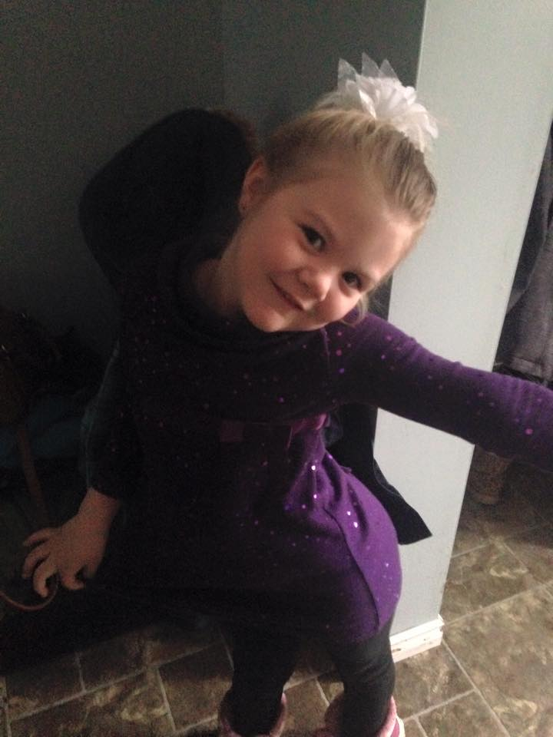
Ireland-Born January 3, 2009 Classic CMTC, left arm afflicted
Ireland was born with her left arm very black with purple showing in a marble pattern all the way up to her left shoulder. We saw a number of pediatric specialists and dermatologists who could not figure out what was wrong with Ireland’s arm for 9 months we were repeatedly told it was a bad bruise with a crushed artery from her birth. Ireland developed early in her cognitive functioning and began to speak by ten months of age. However by twelve months she was still unable to crawl and was unable to take her first steps until aged eighteen months. She continues to this day to have very poor muscle tone. Our family sought help with a dermatologist in Durham region. He thought he may have a name for what Ireland had but knew nothing about it and said he could not help us. I researched everything and eventually found the CMTC organization in the Netherlands. I was able to make contact with Lex and two weeks later we were on our way to Washington D.C. to the US Conference and an evaluation from Dr. Oranje. Ireland was diagnosed with classic CMTC on July 18th, 2011. We have attended conferences in the US on several occasions and finally two years ago were given a following specialist dermatologist Dr. Pope at Sick Kids in Toronto.

Slide 9
After Ireland was diagnosed and began to be followed here at Sick Kids it was recommended that she saw Dr. Archer
at Hotel DIEU Hospital in Kingston to be regularly monitored for glaucoma. Ireland has always had clear scans. Ireland has some sun sensitivity and wears polarized sunglasses and high UV sunscreen while outside to protect her skin. We have been very fortunate as she has had no complications from her CMTC to date. Ireland does tend to have dental problems and has become easily susceptible to viruses (appears to have lowered immunity). Often when she begins a cold it turns quickly to bronchitis or pneumonia and we have learned to try and get ahead of these things by treating early symptoms.
In January 2011 Ireland underwent a skin biopsy of her afflicted left arm area, and the sample was sent to Dr. Patel geneticist at the Vancouver children’s hospital where he is conducting a study on CMTC. Ireland healed well from her biopsy though it took a bit longer and we had to watch carefully for infection. Dr. Patel is still accepting samples of Classic CMTC patients for his study in this area.
In 2014 after a trip to the US for the annual conference it was brought to our families attention that there were other families in Canada that wanted to be involved but had no idea where to seek help. We knew this first hand as it had taken so long for us to get a diagnosis and follow up care. We decided to proceed with developing the Canadian CMTC Foundation. A Not-For-Profit Organization in Canada to raise awareness and support for patients, families and caregivers with those afflicted with CMTC. We have joined with the Netherlands organization in order to provide the most up to date information and to stay ahead of the curve on news in this field.
It was through extensive fundraising and generous donations that I was able to hire a firm in order to get our not-for-profit status. From start to finish it took well over a year before we were finally truly in existence.

Slide 10
The Beta Sigma Phi Sorority gave large amounts of money to help me get started and it was through this that we were finally given our status. Over the past two years our board of directors has come together to fundraise to be able to hold our first and now second medical conferences.
The following fundraising activities have taken place:
Quilt Auction
Christmas Basket
World’s Finest Chocolate Sales
Easter Basket Raffle
Awareness Ribbons Sales
CMTC Swag sales
Last year we raised enough money to pay for half of our conference. I applied for a grant from Sick Kids and although we did not make the first round we were told in our return letter to please apply again the following month. I did reapply the following month for the sharing of information grant and we were awarded. We are so thankful for Sick Kids and their generosity to bring us together.
This year things were a bit different we did not receive any monies from grants and spent most of our time between conferences fundraising for this year. Thanks to the Cobourg Legion and their women’s auxiliary for donating the hall and all the food we were again able to bring everyone together for a special day.
We would like to hear from you!! What are some of your fundraising ideas? Would you like to join our board? We want to know what you think! Please talk with Jennifer Cormier.

Slide 11
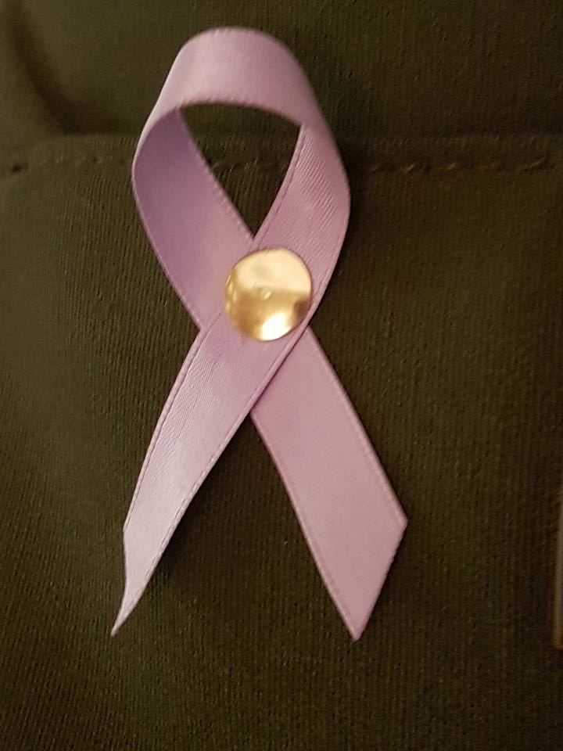
CMTC-OVM Awareness Ribbons
This year we have purchased some CMTC Awareness Ribbons they are available on our back table for $2.00 each

Slide 12
We have SWAG! Order your CMTC t-shirts, mugs, pens and more and help us raise awareness. Purchases can be made at www.canadiancmtcfoundation.com

Slide 13
Membership
Membership dues will be paid on a yearly basis and will be $34.00 per year. Invoices will be emailed to each family who wishes to become members and they can choose a method of payment. This will provide members with access to the Canadian website members pages as well as to the Netherlands Organization website. Dues will go directly towards holding conferences and for obtaining speakers for the conferences that members wish to have present. Any extra donations if there is any will go towards a fund for Dr. Patel’s research on the genetics of CMTC.. Each year we hope to hold the conference in locations closest to our members knowing some members are coming from quite far, the next conference could be held closer to them. We thank you continually for your support and welcome all of you to our family!

